Slide 1

Coursework 1: Pet Shop
Student number: M00719709

Slide 2
Introduction
Introduction
A vector data structure will be used to hold the stock.
The system allows the user to perform all the necessary functions requested from the scenario.
The items will be a categorised. Each category, such as 'Pet Food' inherits from the base class of item. The program will be able to save or load data from a text file wherein each line will represent an item.
This project will include:
Program flow (UMLs)
Implementation (Approach, Makefile, BitBucket)
Testing approach
Conclusion

Slide 3
Program flow
This section will include the following UMLs:
Use case diagram
Use case specification
Class diagram
Activity diagrams
Sequence diagram

Slide 4
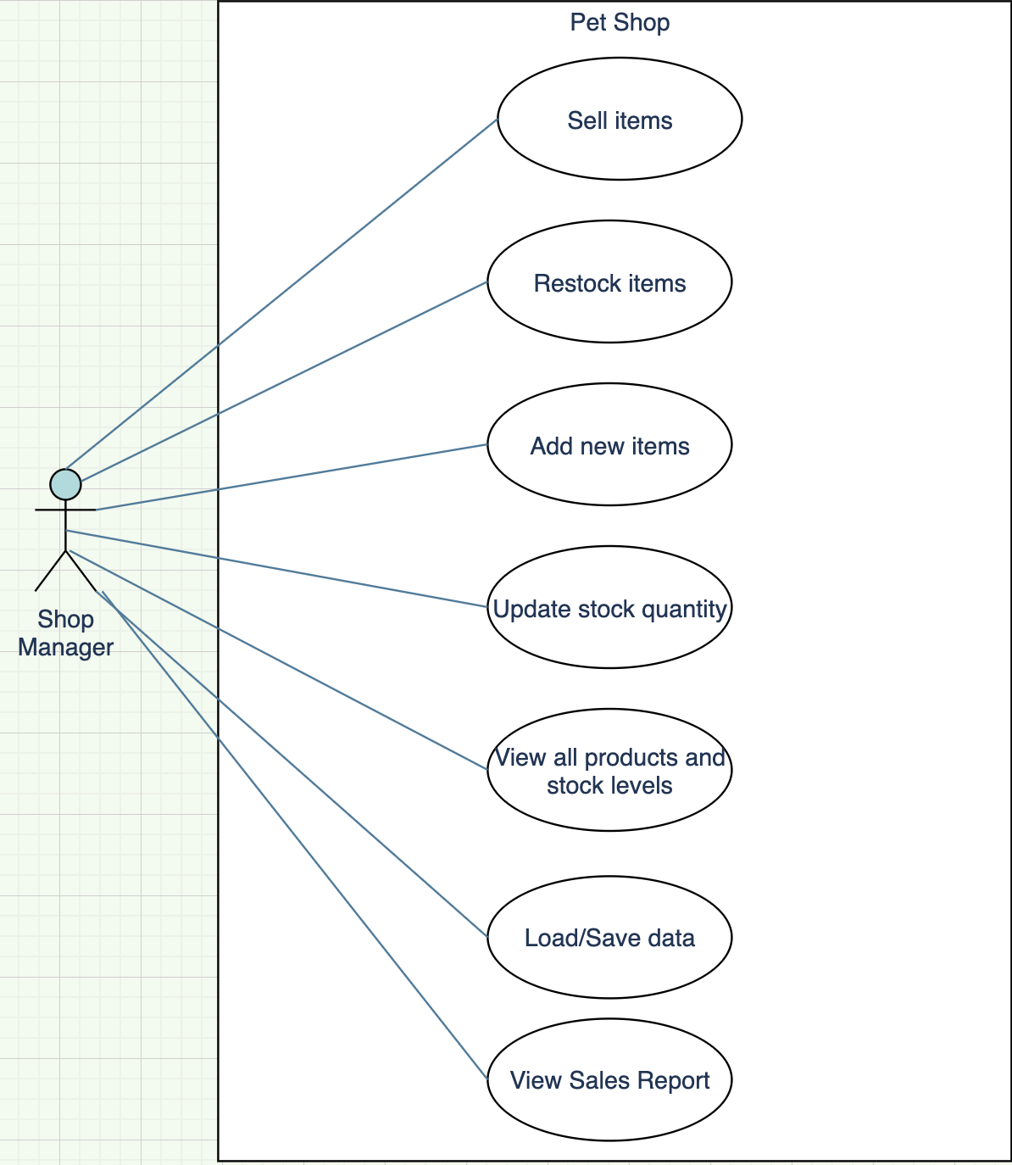
Use case
The use case demonstrates the options the console management system offers.
From the main menu, the user can choose any of the actions such as 'Sell items'.

Slide 5
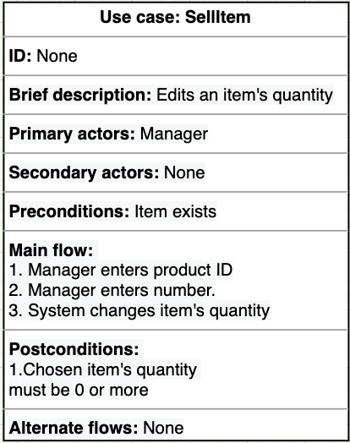
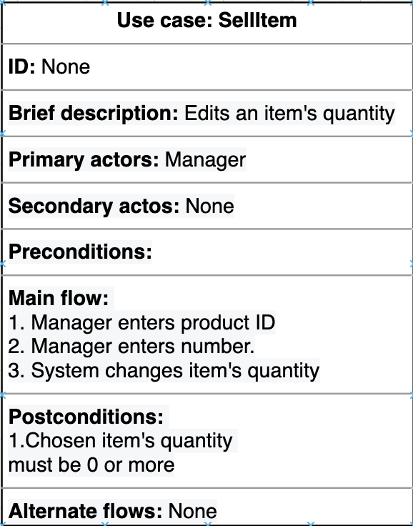
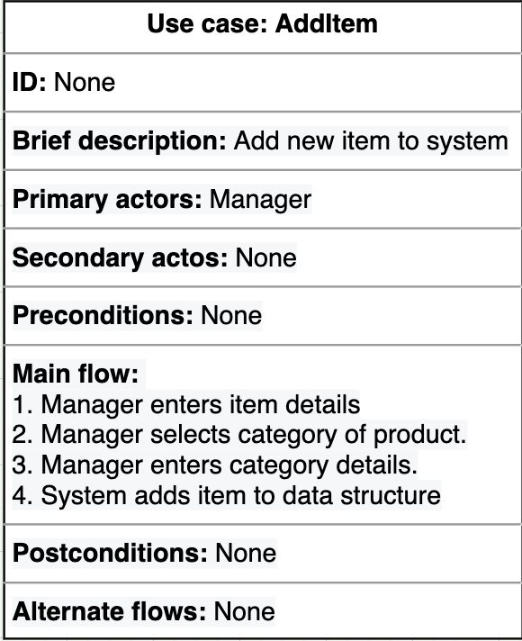
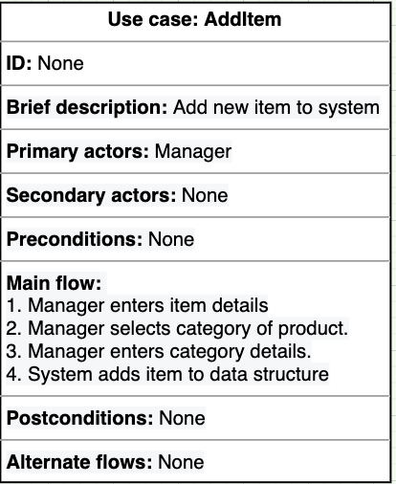
Use case specification
Table 1
Table 1
Quantity of the desired item to be sold must not go below 0.
After the two prompts, the system will decrease the item's quantity by the desired amount.
Table 2
Table 2
There are no conditions for this function.
System will create an instance of the item and add the item to the vector of items.

Slide 6
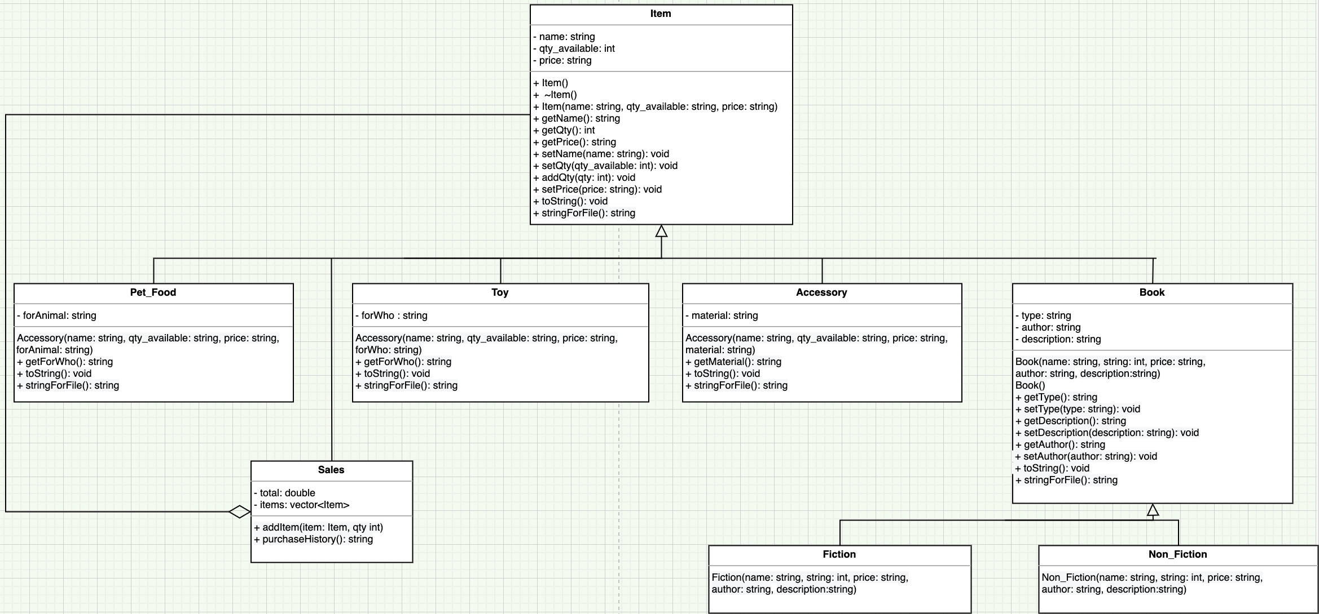
Class Diagram
The subclasses of Item (Pet_Food, Toy, Accessory or Book) are like categories and inherit the attributes of Item.
The subclass Sales includes a vector that holds a record of items.
The data type string was used for quantity available and price. This made the system less prone to error inputs such as very long numbers or to ensure that the user input enters two decimal points for the price when adding a new item.

Slide 7
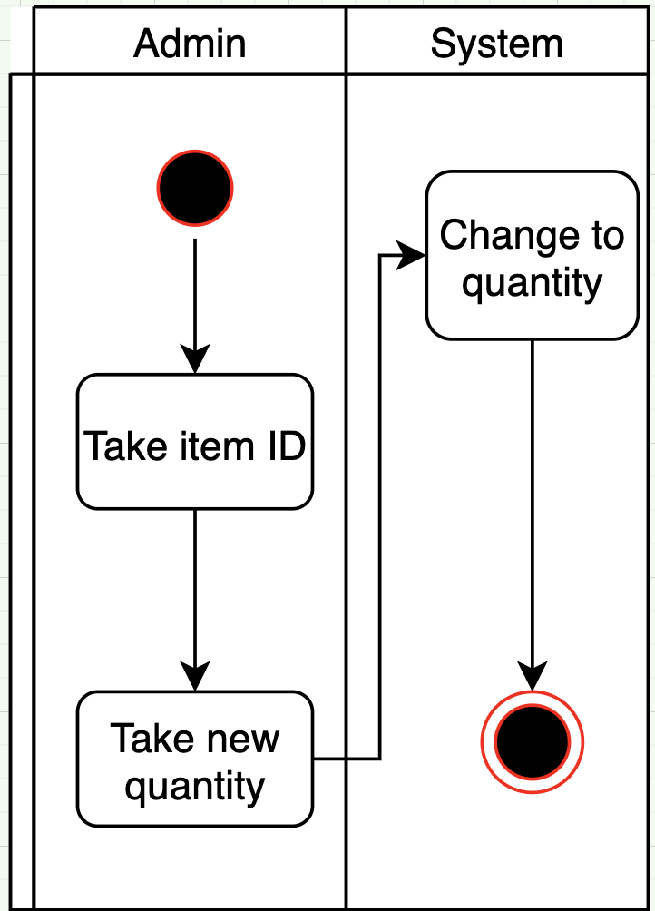
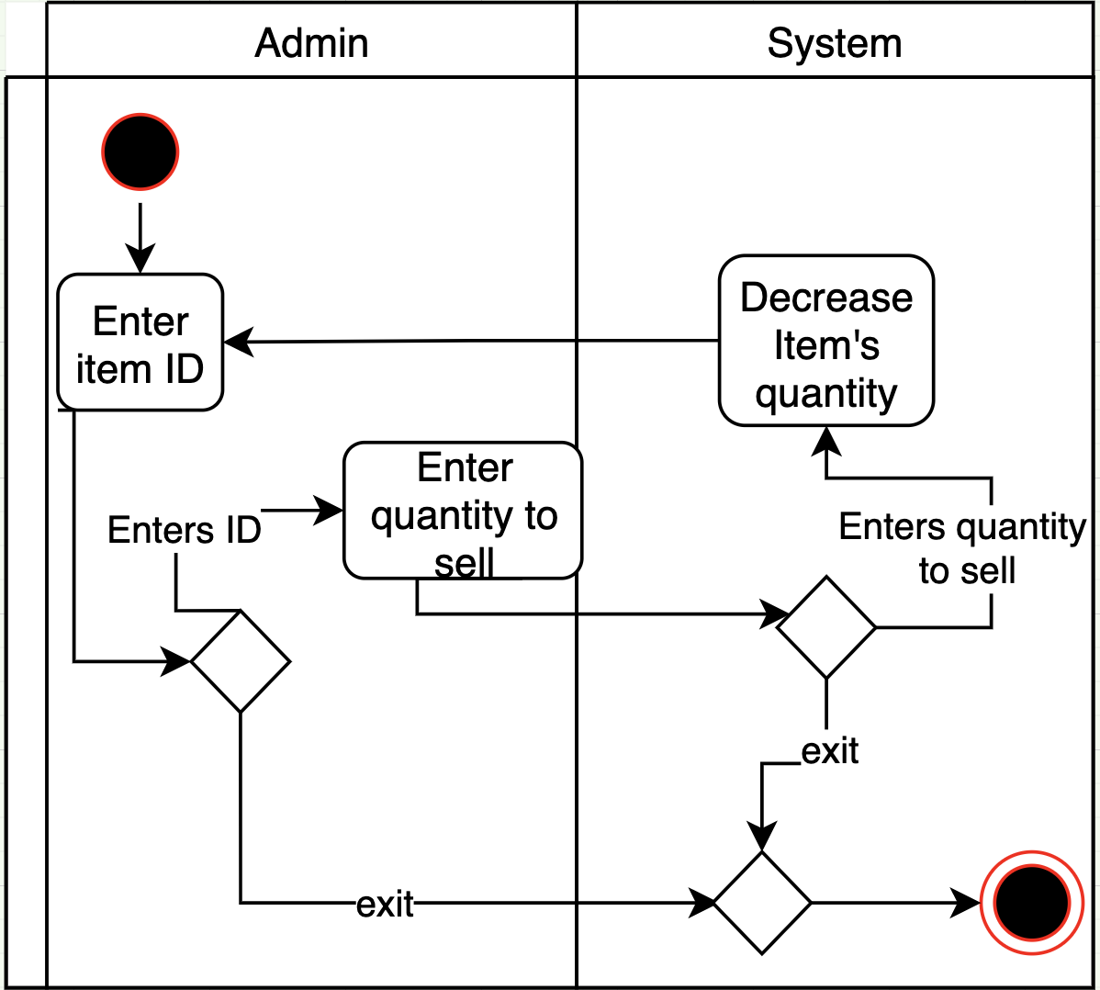
Activity diagrams
The user may exit at any time.
Implementation
The actual program has implemented all the activity diagrams. The system performs all the necessary actions displayed.

Slide 8
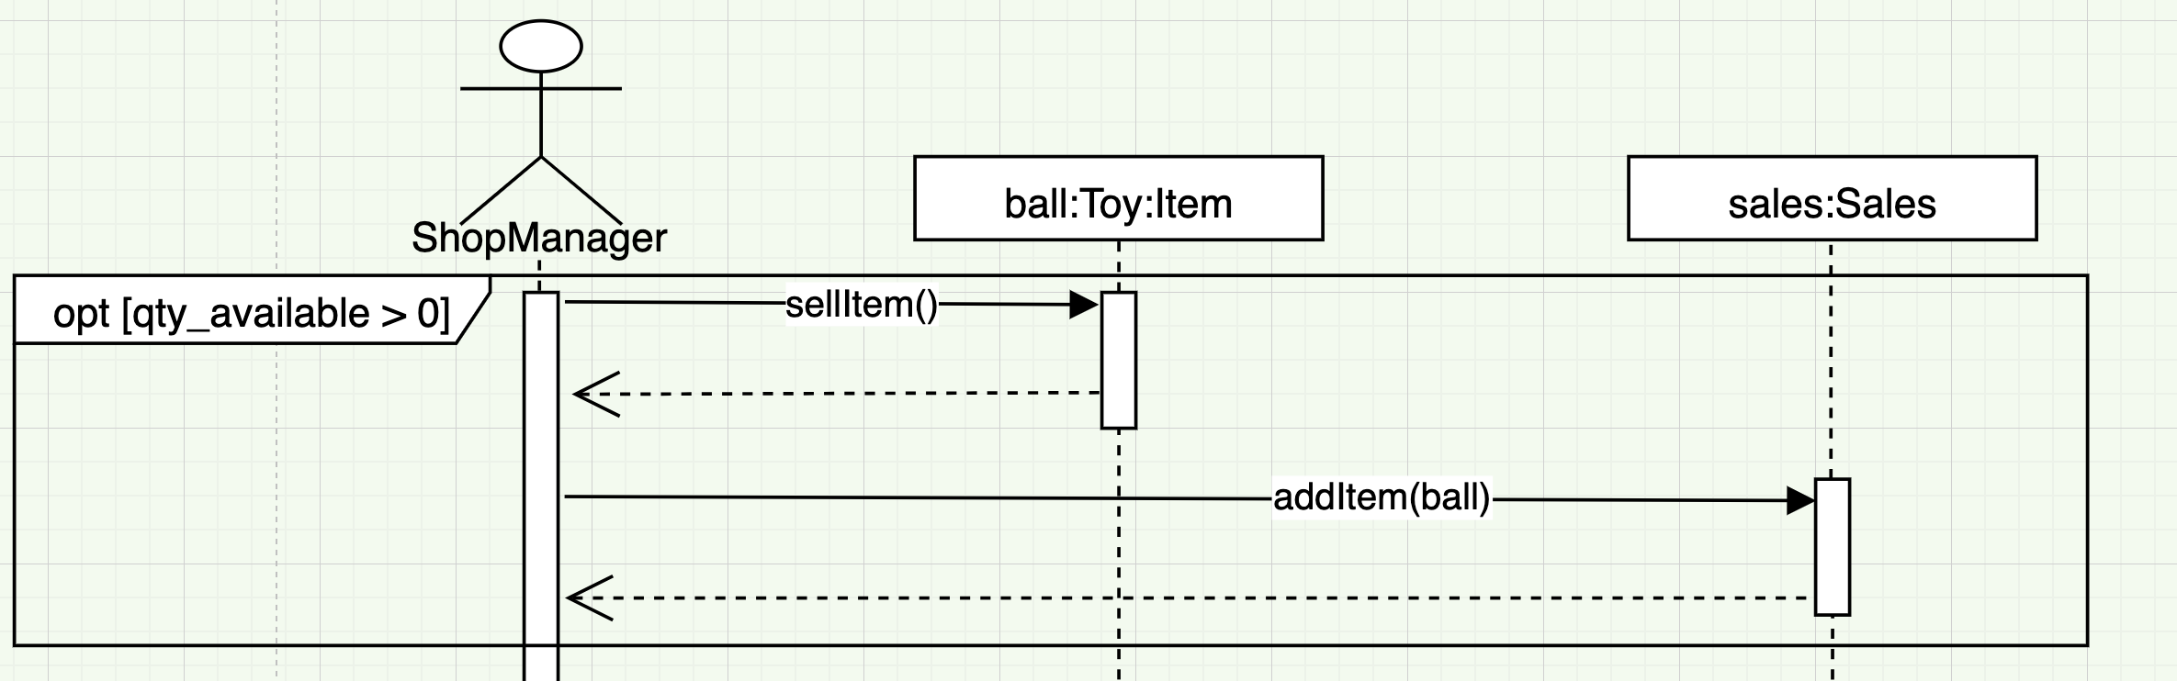
Sequence diagram
If the quantity available of the ball is more than 0, then the system will add the sale to the 'sales' object.
The sales object contains a vector which holds a record of sales (Item objects) made.

Slide 9
Implementation
This section will include the following:
Approach
Makefile
Version control (BitBucket)

Slide 10
Approach
The class diagram gave me an object-oriented map of the program and a static view of the application. This helped me understand how inheritance will assist me in creating categories of items such as pet food.
I applied the class diagram to the software with the aid of sequence diagram, I was able to see how the objects will interact with each other and which functions were required in the classes.
The activity diagram helped build the application's core functions such as the prompts for the main menu, or adding, or selling an item in the shop.

Slide 11
Makefile
Typing 'gcc Application.cpp -o PetShop –std=c++11' and including all the source files within the folder every time to compile the program was not necessary.
The project compiled automatically after entering the command 'make'.
The makefile for my project kept track of the changes and compiled my program automatically after the command 'make' was used.

Slide 12
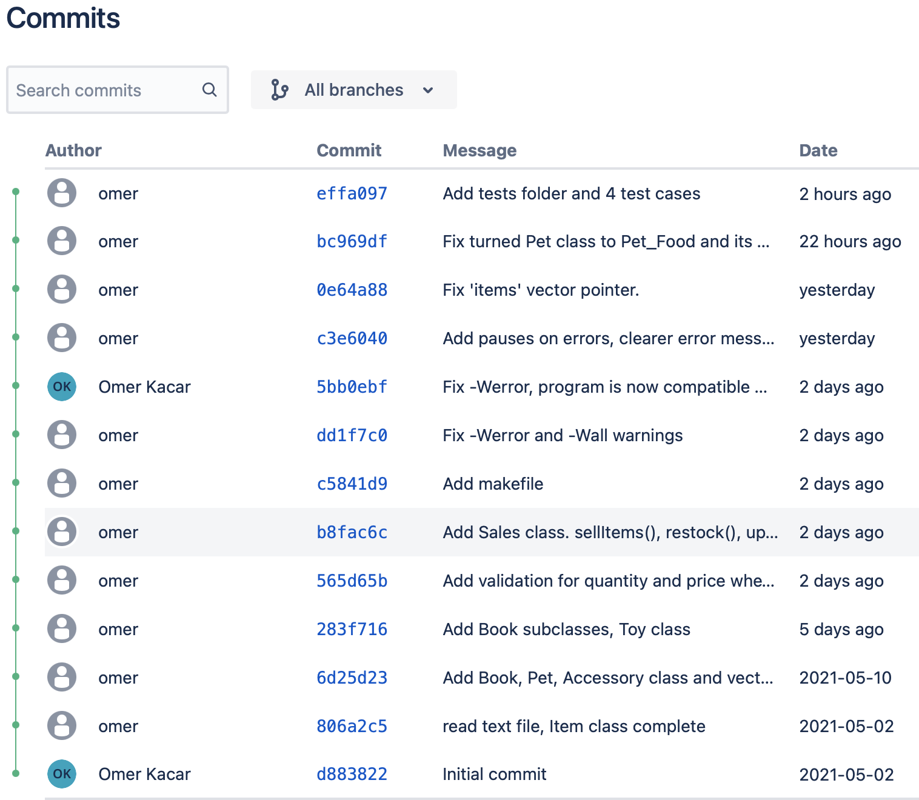
Version control
Bitbucket's version control system 'git' assisted me in keeping track of the changes as I made commits.
I could always revert changes back to a previous commit in the case of an error.
There was greater security and practicality when building the project.
'git' assisted me when I transferred from a MacOS to a Windows 10 operating system.
I could compare the difference between commits.

Slide 13
Testing approach
This section will include the following:
How and why Catch2 was used
Test case table

Slide 14
Catch2
Included the catch.hpp header file to the test source file.
Test functions such as testing whether given inputs are all digits. Or whether the given input contains two decimal places (price of the item).

Slide 15
Test case table
Test case | Description | Test data | Expected Result | Actual Result | Pass/Fail
1 | Check if input is a positive integer. | > "-1" > "91283743182398912383924" > "43.2" > "æ…≥≈'«≥÷«æ" > "5" | Non-positive integers to be false and the "5" to be true. | All assertions were false and not positive integers except for "5". | Pass
2 | Check if input consists of 2 decimal places. | > "91283743182398912383924.32" > "32.232" > "" > "-2" > "32.23" | All assertions to be false, as none are to 2 decimal places, except for "32.23" to be true. | All assertions were false except "32.23" | Pass
3 | Whether sold item will be added to sales report. | > 1 Dog food, total cost: £5.99, grand total: £5.99 > 3 Dog food, total cost: £17.99, grand total £17.97 | A receipt of the item sold, followed by a grand total statement matching the expected receipt | Receipt matched the expected receipt. | Pass
4 | Data written to file is correct | > 23 Hamster Food (Food), for hamster, £3.99 each > 7 Cat nip (Toy), for cat, £6.99 each | > "Hamster Food;Pet_Food,Hamster;3.99;23" > "Cat nip;Toy,Cat;6.99;7" | > "Hamster Food;Pet_Food,Hamster;3.99;23" > "Cat nip;Toy,Cat;6.99;7" | Pass
The table above displays tests such as whether the input is a positive integer.
I used a string input for Test case 1 and Test case 2 (Testing whether the input is a digit or has 2 decimal places)

Slide 16
Conclusion
This section will include the following:
Summary of the work
Limitations
Future approach to the given scenario

Slide 17
Summary
The software passed all the test cases (even edge cases) and is ready to be used to manage the pet shop. The implementation matches the UML diagrams I have designed.

Slide 18
Limitations
The UML diagrams weren't always easy to follow, I added a few extra steps to the activity diagram for adding a new item.
I created virtual functions and destructors to the base class Item, slight deviation from the class diagram.

Slide 19
Approach in the future
More UML diagrams, activity diagrams more detail.
More unit testing techniques could have been made, such as black box testing and gray testing. This is so that even a user with no prior knowledge could perform tests on the program.
The products could have had more unique information. Such as an ISBN for the books.
The user interface could be more user friendly.
The version control would be better with branches when work on a fix was made.

